Slide 1




Policy Utilization Report
1st October 2019 –September 30th 2020
Dallah Group

Slide 2

TOPIC
3
4
5
6
7
8
9
10
11
12
13
14
15
Dallah Hospital - Nakheel Top 18 Claimants - Amount wise
Top 20 Claimants - No. of Claims per Member
AFIA ALNAKHIL Top 20 Claimants - Amount wise
Top 20 Claimants - No. of Claims per Member
Dallah Hospital Namar
Top 10 Claimants - Amount wise
Top 10 Claimants - No. of Claims per Member
Dallah Group overview
Summary of Benefit utilization
Benefit Utilization Percentage-By Providers
Top Providers - Claims Amount wise

Slide 3
CUSTOMER : DALLAH HOSPITAL-NAKHEEL
POLICY NUMBER : 9002023

Slide 4

Top 18 Claimants - Amount wise

Slide 5
Top 20 Claimants - No. of Claims per Member -

Slide 6
CUSTOMER : AFIA ALNAKHEEL
POLICY NUMBER : 9002024

Slide 7
Top 20 Claimants - Amount wise

Slide 8
Top 20 Claimants - No. of Claims per Member -

Slide 9
CUSTOMER : DALLAH HOSPITAL NAMAR
POLICY NUMBER : 9002025

Slide 10
Top 10 Claimants - Amount wise

Slide 11
Top 10 Claimants - No. of Claims per Member -

Slide 12
Dallah Group Overview

Slide 13

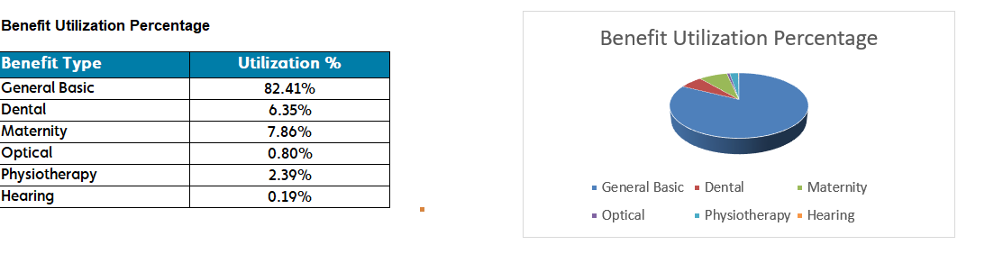
Summary of Benefit utilization
From: 01-Oct-2018 To: 30-Sep-2019
Page 1 of 1
V.01
23-JUL-2019 03:25 PM

Slide 14
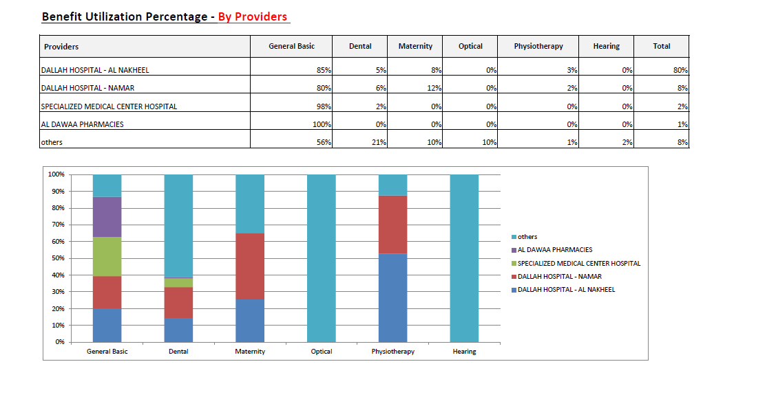
Benefit Utilization Percentage-By Providers

Slide 15
Top Providers - Claims Amount wise
From: 01-Oct-2018 To: 30-Sep-2019
V.07

Slide 16
Top Providers - Claims Amount wise From: 01-Oct-2018 To: 30-Sep-2019
V.07

Slide 17
Top Providers - Claims Amount wise
From: 01-Oct-2018 To: 30-Sep-2019

Slide 18
Top Providers - Claims Amount wise
From: 01-Oct-2018 To: 30-Sep-2019
V.07

Slide 19

THANK YOU

